Slide 1

PROJECT TITLE : PUNERI PRAVAS
PROJECT BASED LEARNING PRESENTATION (REVIEW 1)
GROUP NUMBER : 10
Guided By:-Gauri Mathad ma’am
Project based learning , AIML Department,
P.E.S.Modern College Of Engineering,Shivajinagar,Pune-05

Slide 2


Project Members
Aditya Garje (2321)
Alok Ahirrao (2305)
Raj Dalvi (2317)
Utkarsh Barge (2311)
Mitisha Chawla (2315)
Sumer Awsekar (2309)

Slide 3


MOTIVATION
1.Tour operators can add multiple tour details.
2.Upcoming tours details.
3.Virtual tour option.
4.Upload Destination details with HD images.
5.People can also order famous foods in pune from our website.

Slide 4


PROBLEM STATEMENT
Our website can solve the problem of handicapped tourist peoples , senior citizens who have wish to travel various places but can’t visit due to their problems.
Our Team Provides the option of the virtual tour by which the handicapped tourist peoples , senior citizens can enjoy the tourism only with the help of the smart phone and our website.

Slide 5
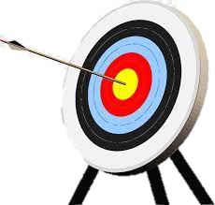
AIM AND OBJECTIVES OF
THE PROJECT
Aim:-
My long term objectives are to create as much high quality content, covering as many places around the world as possible.
Objectives:-
Our website can solve the problem of handicapped tourist peoples , senior citizens who have wish to travel various places but can’t visit due to their problems.

Slide 6

INTRODUCTION
Tourism has turned out to be an economic booster contributing to the economic development of many countries over the last few decades.
People see holidays as a necessity, and not as luxury in the present scenario.
Tourism calls for coordination and cooperation between travel agents, tour operators, and tourists.
Tourism has a few major elements − destinations, attractions, sites, accommodation, and all ancillary services.

Slide 7

BACKGROUND AND EXISTING SYSTEM PROBLEMS
We faced many problems while creating our website. Some of the Major Problems are Mentioning Below:-
Browser: - Some Functions of our website work on some Browser while some not working on some browsers.
Image Editing:-We faced many issues while inserting images and Videos but Resolved with the help of canva and Adobe Photoshop.
Responsiveness:-We faced the issues related to Responsiveness because of the dimensions ratio vary from laptop to laptop.

Slide 8

METHODOLOGY
Language used:- We have used the HTML Language and CSS.
Software used:-We have used the visual studio code and sublime text editor software.
Sections Created:-Home, Historical, Devotional, Educational, IT Park, Cuisine and shopping.

Slide 9

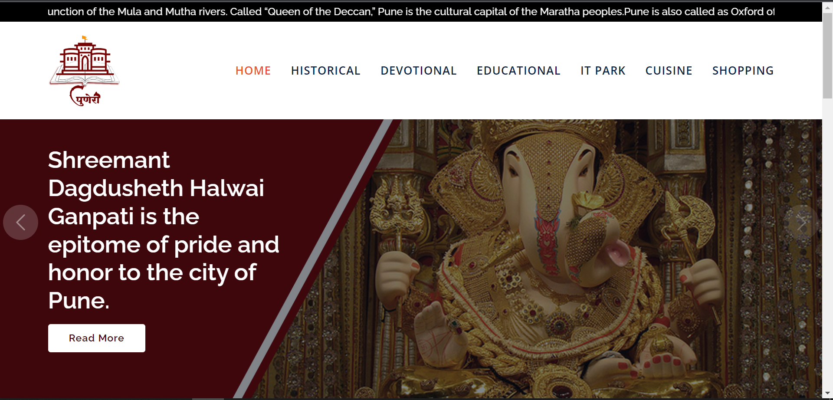
SCREENSHOTS OF WEB PAGE

Slide 10

CONCLUSIONS
By our website we can conclude that the virtual tour is finally available in your pocket.

Slide 11





REFERANCES
1) W3 schools
2) Google Maps
3) Software Engineer
4) Youtube
5) Google Images

